Slide 1
Expedia Hotel Recommendations
Shiv Lalapet, Alex Li, James Lu, Zander Tedjo

Slide 2

Introduction
Expedia is an online travel company
Expedia
Trivago
Expedia uses search parameters to adjust their recommendations

Slide 3
Problem Description
Contextualize and predict customer behavior
Given a user ID, assign to one of 100 hotel cluster
Multi-classification problem with 100 classes

Slide 4
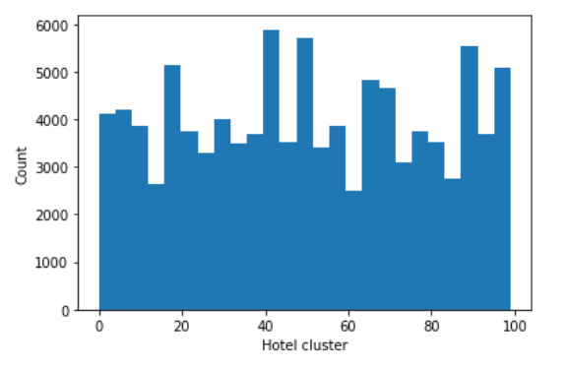
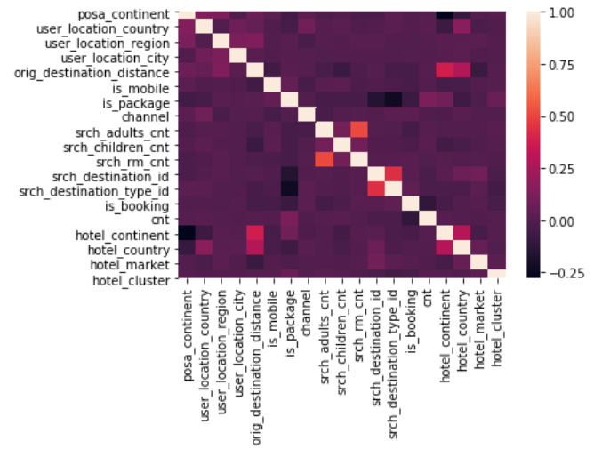
Exploratory Data Analysis
Target Class Distribution
Correlation Heatmap

Slide 5
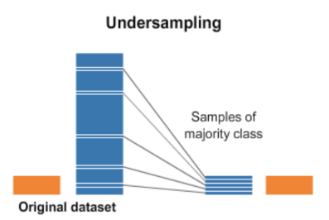
Preprocessing
Reduce data size
Removed samples due to size and missing values
Removed features that were unnecessary
Resampling
For equal class distribution
Quicker processing

Slide 6
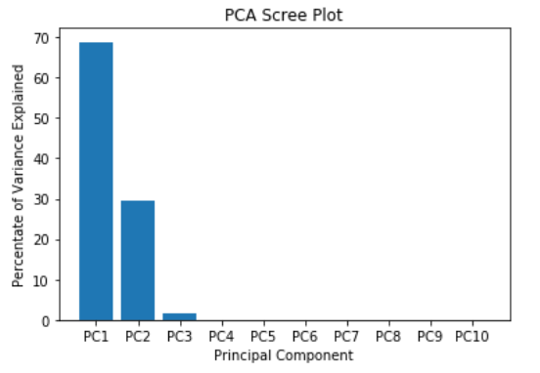
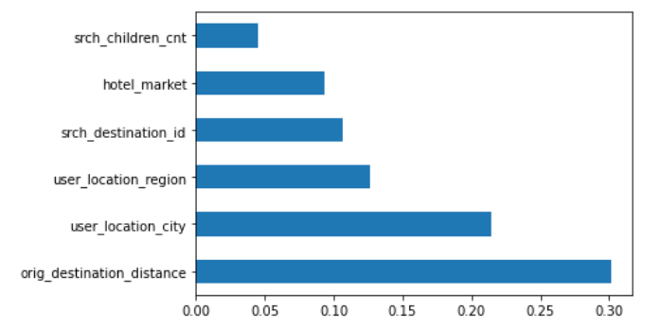
Feature Selection/Extraction
Feature Importances

Slide 7
Models
Logistic Regression
K-Nearest Neighbors
Random forest
XGBoost
Light GBM
Cat Boost
Neural Network

Slide 8
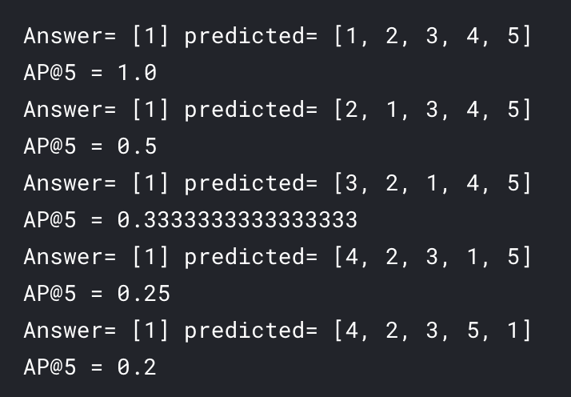
Evaluation
Multiclass ROC AUC
Mean Average Precision @ K • Popular for recommendation engines • K = 5

Slide 9
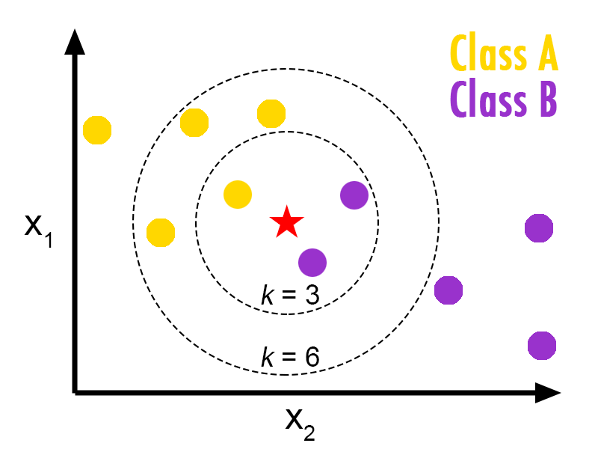
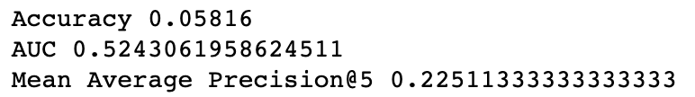
K-Nearest Neighbors
Input is assigned class of its nearest neighbors
Hyperparameters: • K = 5

Slide 10
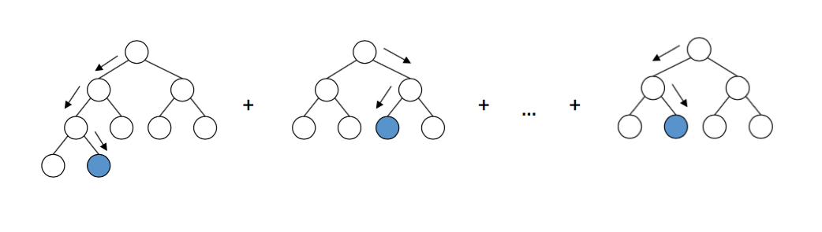
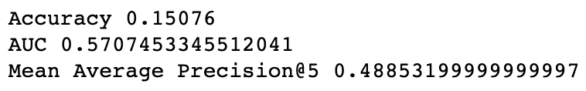
XGBoost
Gradient boosted decision trees
Hyperparameters: • n_estimators = 400 • learning_rate = 0.2 • max_depth = 3 • min_child_weight = 1

Slide 11
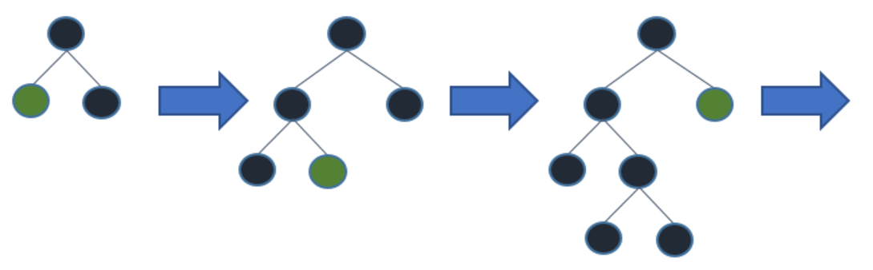
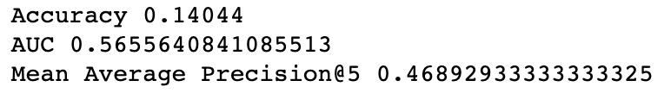
LightGBM
Faster gradient boosted decision trees • leaf-wise splits
Hyperparameters: • n_estimators = 41 • learning_rate = 0.1 • num_leaves = 30 • min_data_in_leaf = 100

Slide 12
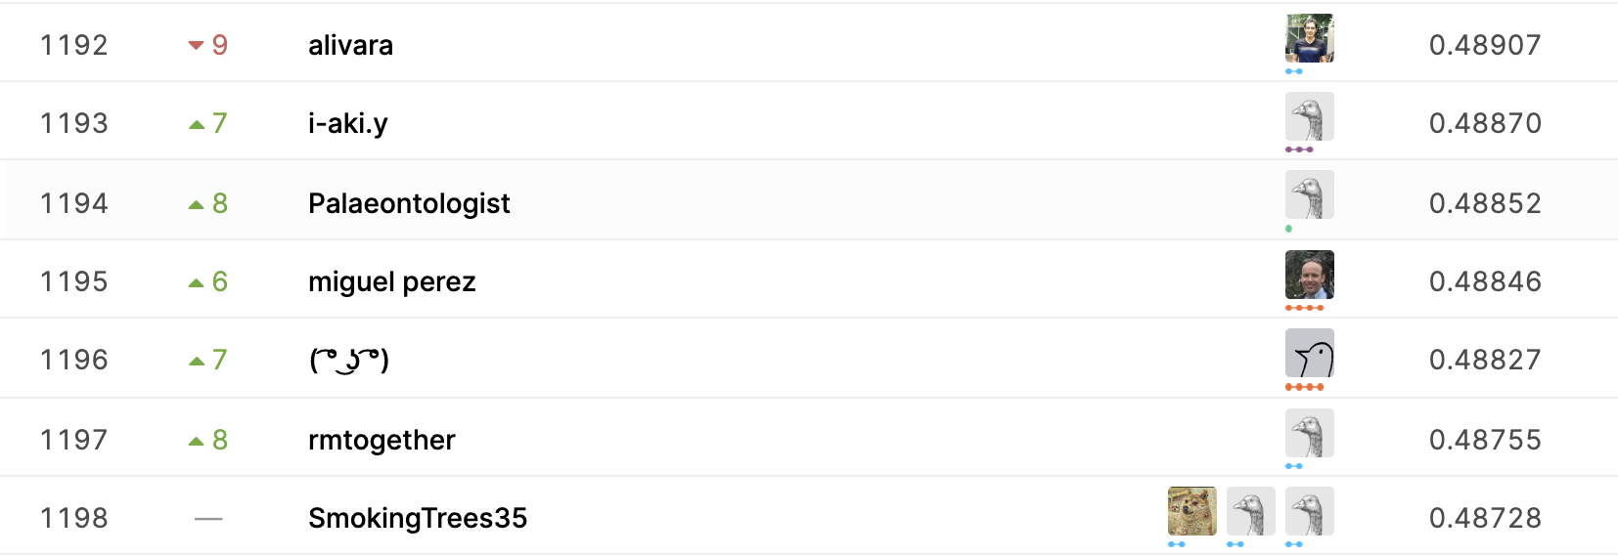
Evaluation
Best Mean Avg. Precision: 1. XGBoost: 0.4885 2. LightGBM: 0.4689 3. K-Nearest Neighbors: 0.2251
1,973 Kaggle Teams • Top 10%: 0.49916 • Top 50%: 0.49476 • Top 75%: 0.30282

Slide 13
Next Steps
Continue to make adjustments to the models
Tune hyperparameters, increase the amount of data, model ensembles
Learn from the winner of the Kaggle competition
Grouped columns that uniquely identified user and hotel locations
LIBFFM implementation using categorical features
Xgboost “rank:pairwise”: features per row relative to corresponding cluster

Slide 14
Questions?

Slide 15
References
Github Repo: https://github.com/alexlisa9/finalProject_EE461P
E. Rencberoglu, “Fundamental Techniques of Feature Engineering for Machine Learning,” towardsdatascience.com, April 1, 2019. [Online]. Available: https://towardsdatascience.com/feature-engineering-for-machine-learning-3a5e293a5114.
Kaggle, “Expedia Hotel Recommendations,” kaggle.com, 2016 [Online]. Available: https://www.kaggle.com/c/expedia-hotel-recommendations/data.
P. Khandelwal, “Which algorithm takes the crown: Light GBM vs XGBOOST?”, analyticsvidhya.com, June 12, 2017. [Online]. Available: https://www.analyticsvidhya.com/blog/2017/06/which-algorithm-takes-the-crown-light-gbm-vs-xgboost/?fbclid=IwAR2RKaO1nUU4wztJk9LUIT3HLQVwiX6On-2_dvuca1Gjq_ZCsEMC5LNaDEk.
Scikit Learn, “Multiclass and multilabel algorithms,“ scikit-learn.org [Online]. Available: https://scikit-learn.org/stable/modules/multiclass.html.

